Slide 1

Presentacion
Notes:
textbox
No alt text provided
INFORME INGRESOS 2021 - 2024
No alt text provided

Slide 2
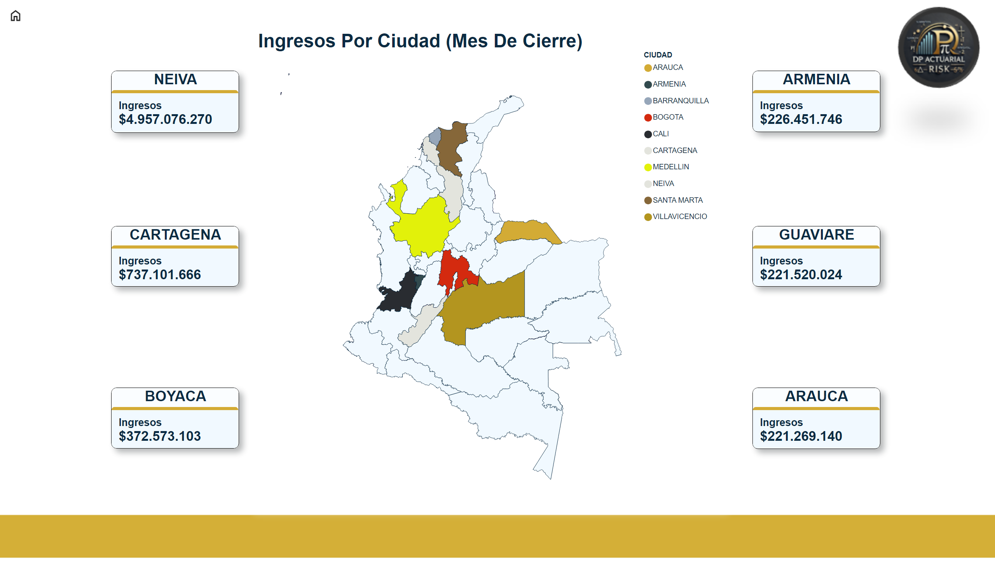
1
Notes:
Ingresos Por Ciudad (Mes De Cierre)
No alt text provided
GUAVIARE
No alt text provided
ARMENIA
No alt text provided
CARTAGENA
No alt text provided
BOYACA
No alt text provided
ARAUCA
No alt text provided
NEIVA
No alt text provided
Menu
No alt text provided
image
No alt text provided
slicer
No alt text provided
slicer
No alt text provided
slicer
No alt text provided
slicer
No alt text provided
slicer
No alt text provided
slicer
No alt text provided
slicer
No alt text provided
shape
No alt text provided

Slide 3
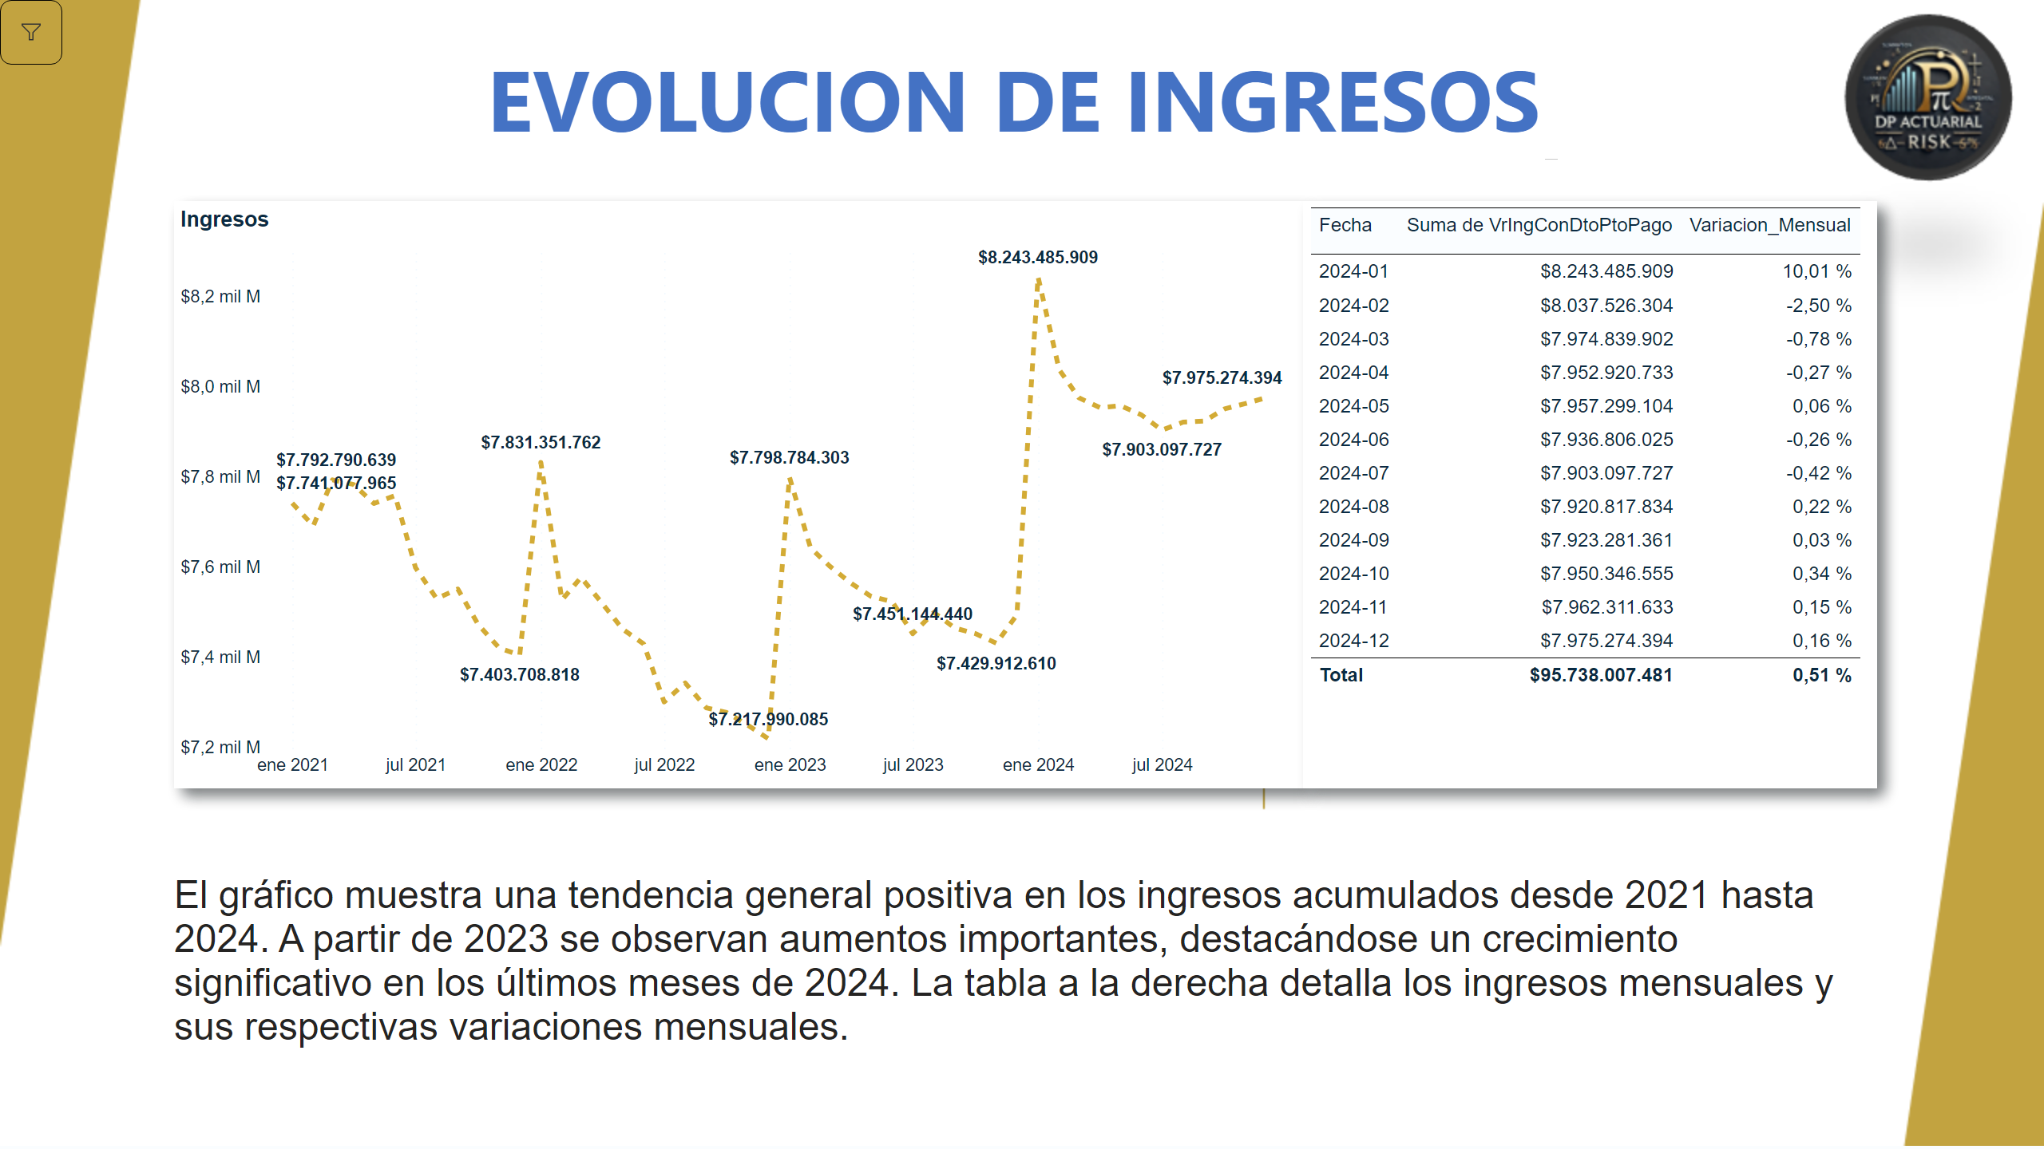
2
Notes:
EVOLUCION DE INGRESOS
No alt text provided
Ingresos
No alt text provided
slicer
No alt text provided
tableEx
No alt text provided
textbox
No alt text provided
shape
No alt text provided

Slide 4
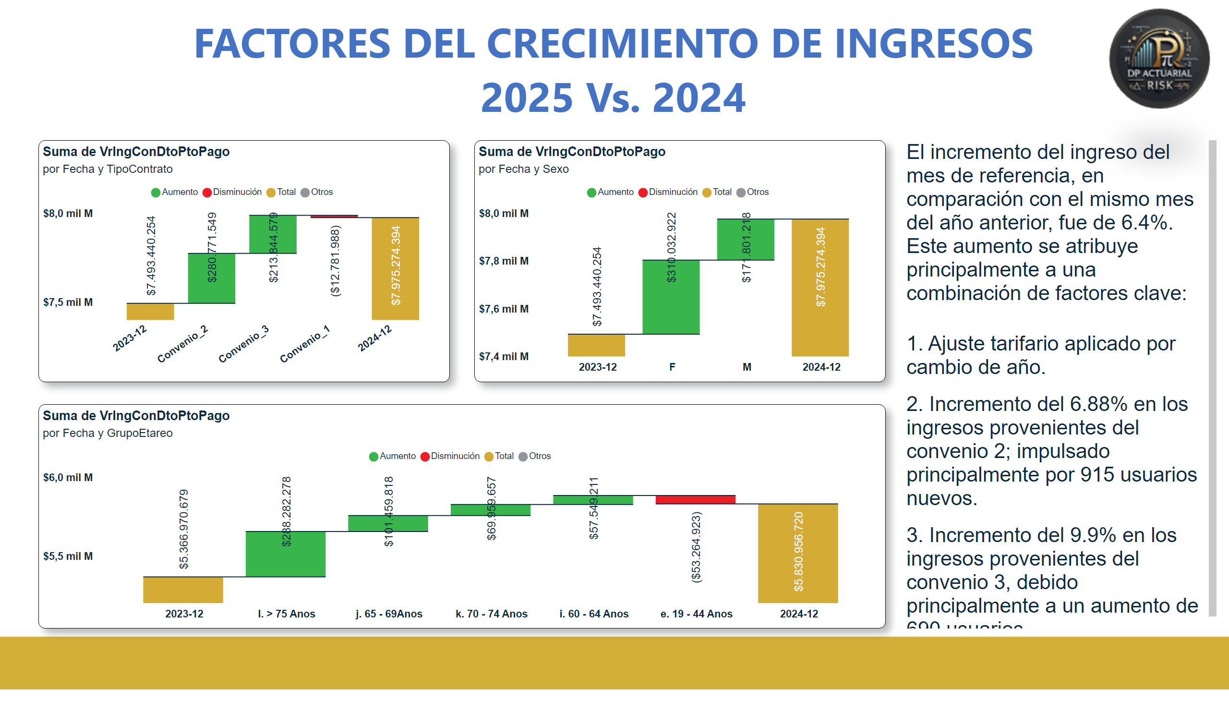
3
Notes:
waterfallChart
No alt text provided
waterfallChart
No alt text provided
waterfallChart
No alt text provided
FACTORES DEL CRECIMIENTO DE INGRESOS 2025 Vs. 2024
No alt text provided
textbox
No alt text provided

Slide 5
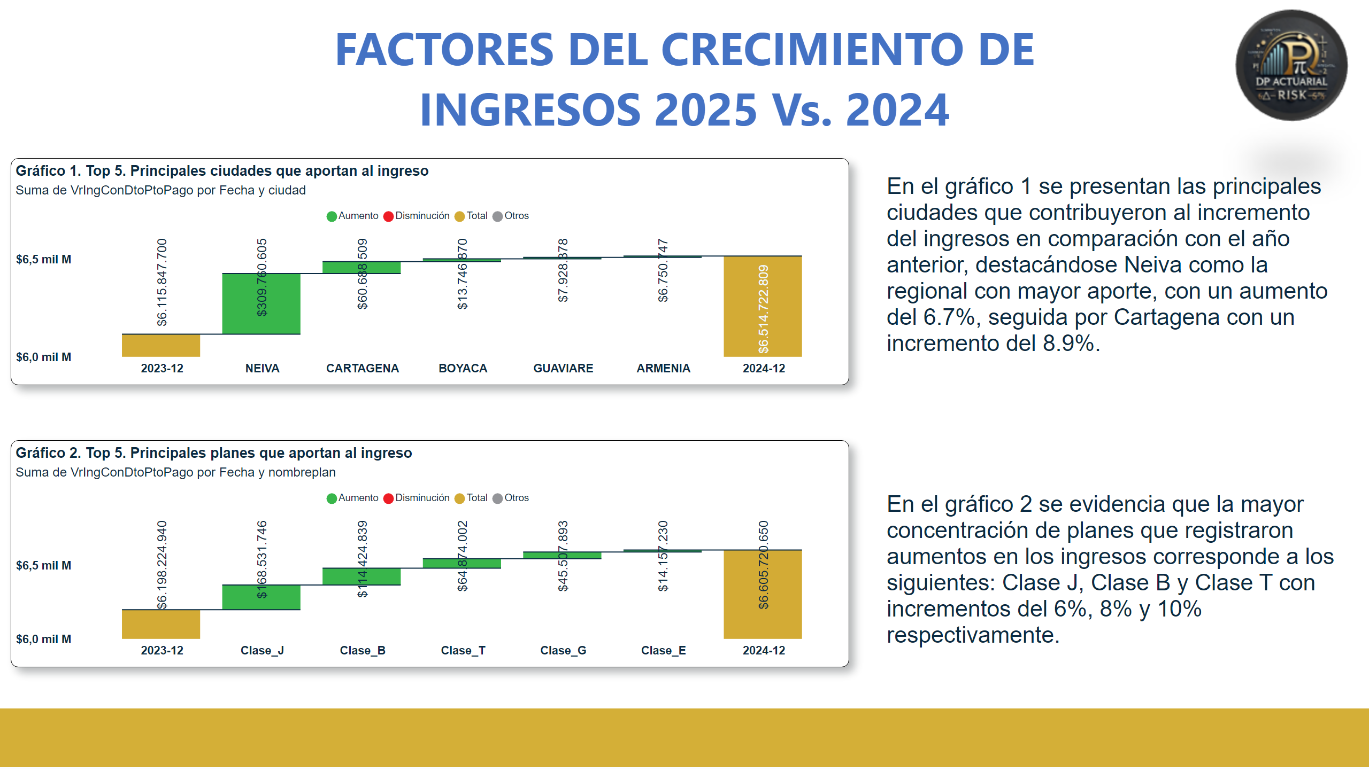
4
Notes:
Gráfico 2. Top 5. Principales planes que aportan al ingreso
No alt text provided
Gráfico 1. Top 5. Principales ciudades que aportan al ingreso
No alt text provided
FACTORES DEL CRECIMIENTO DE INGRESOS 2025 Vs. 2024
No alt text provided
textbox
No alt text provided

Slide 6
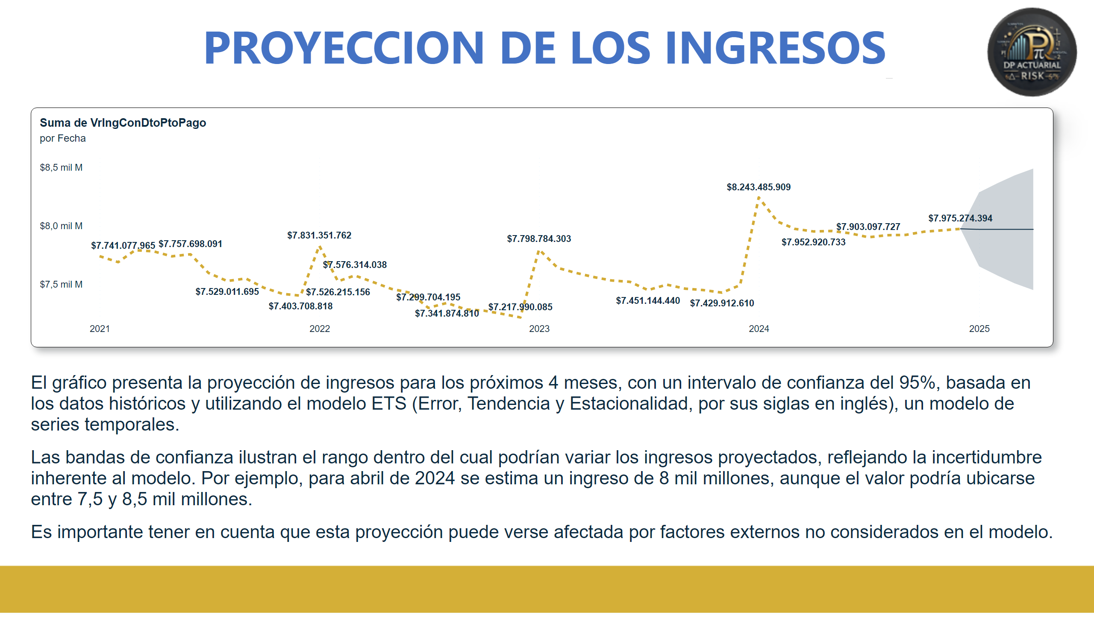
5
Notes:
PROYECCION DE LOS INGRESOS
No alt text provided
lineChart
No alt text provided
textbox
No alt text provided

Slide 7
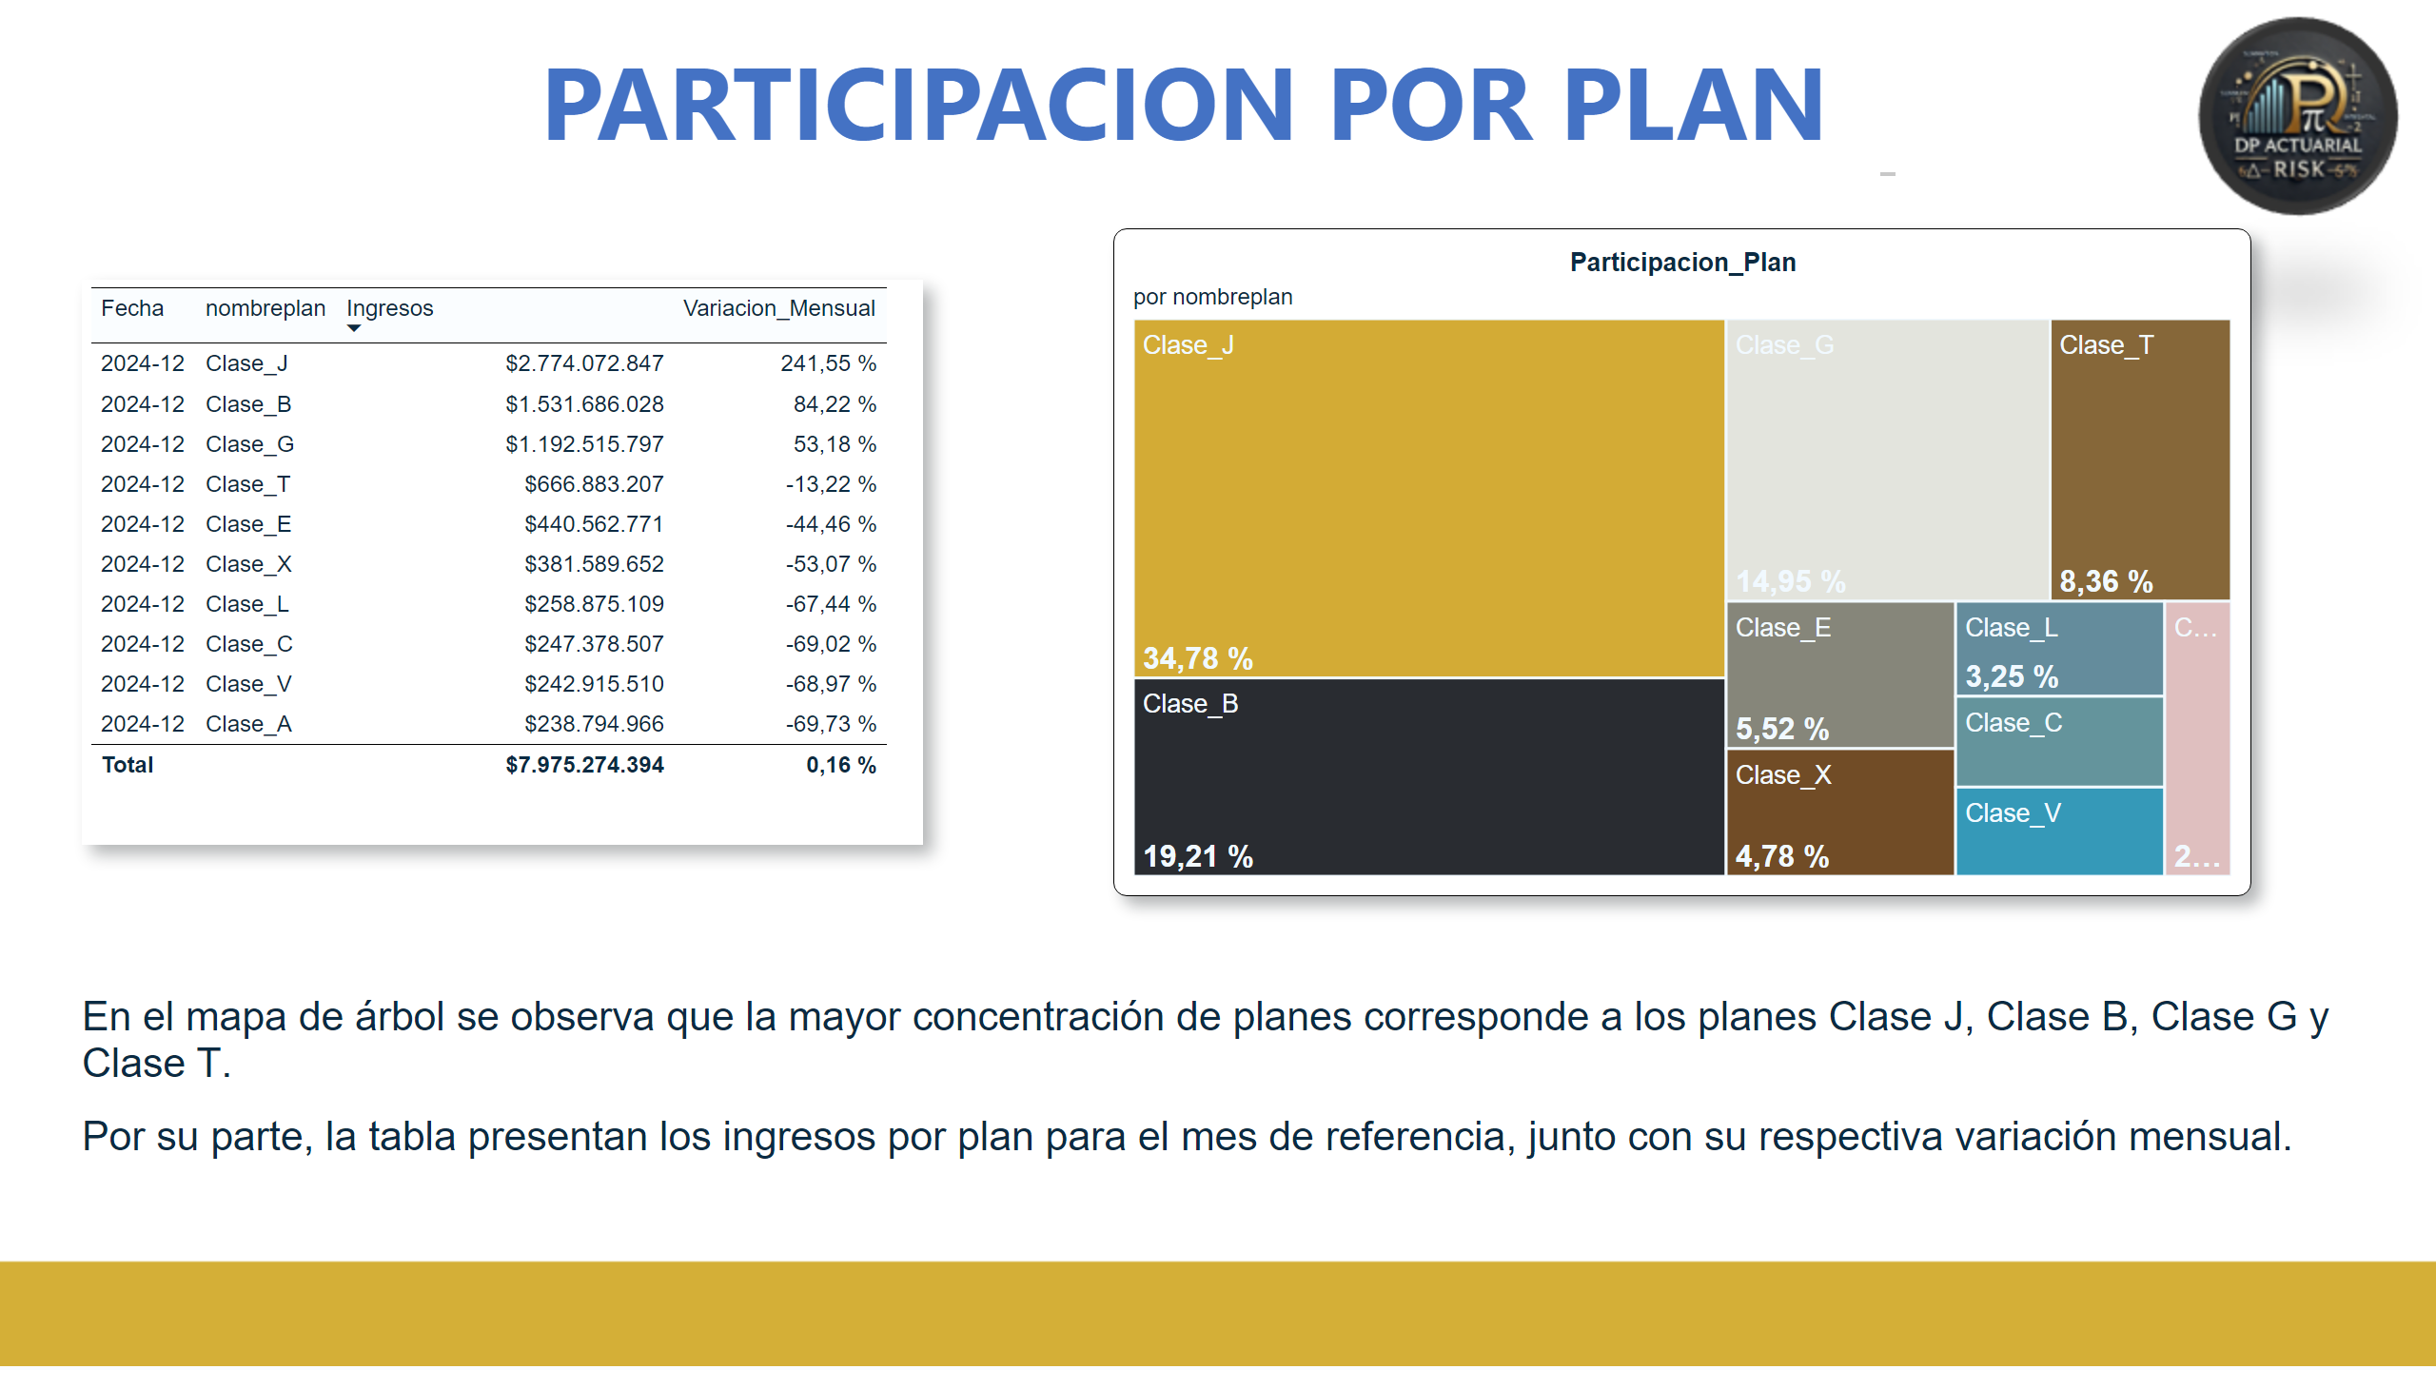
6
Notes:
PARTICIPACION POR PLAN
No alt text provided
tableEx
No alt text provided
treemap
No alt text provided
textbox
No alt text provided
slicer
No alt text provided

Slide 8
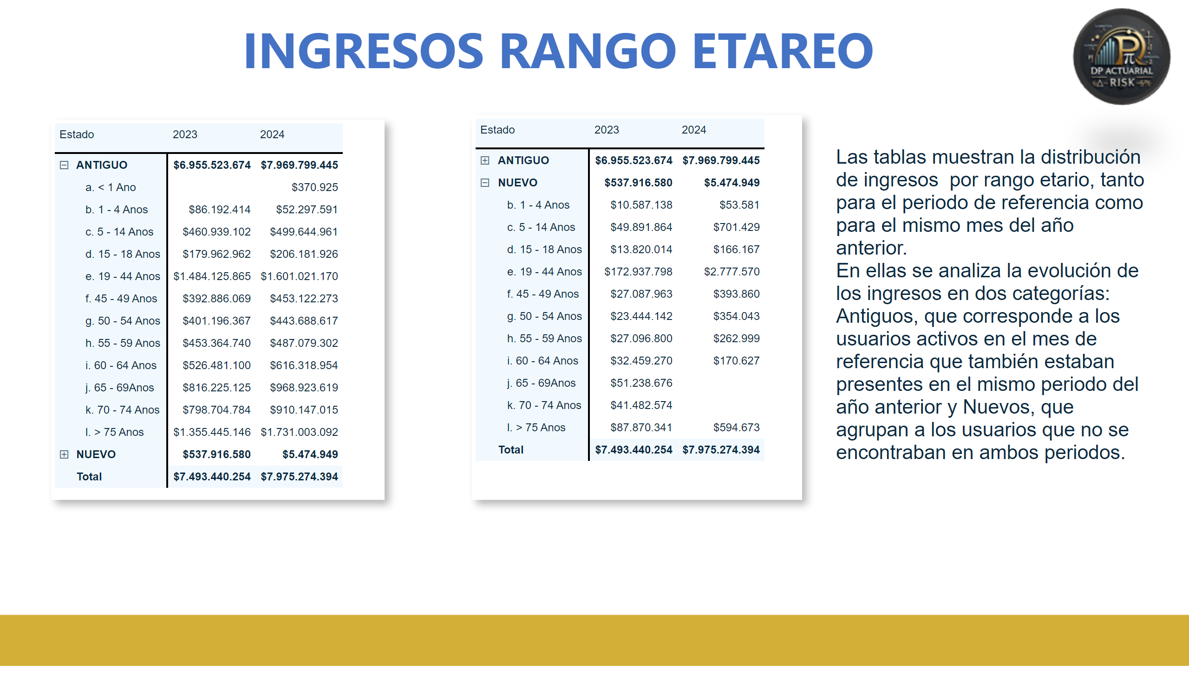
7
Notes:
pivotTable
No alt text provided
INGRESOS RANGO ETAREO
No alt text provided
pivotTable
No alt text provided
textbox
No alt text provided

Slide 9
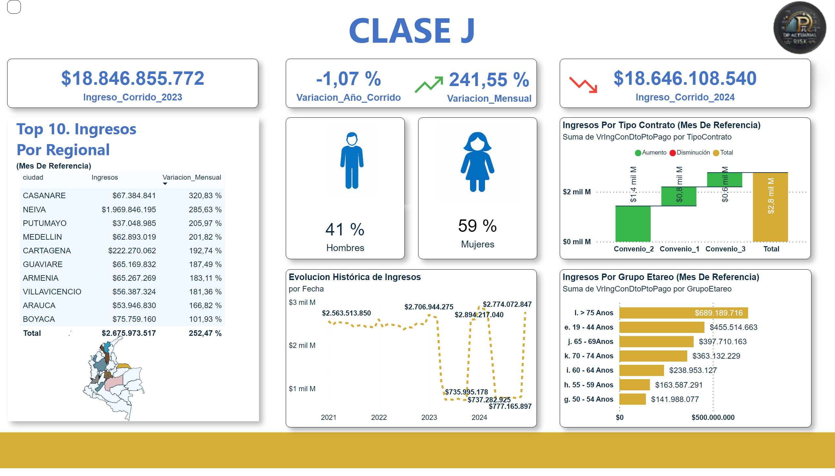
CLASE J
Notes:
CLASE J
No alt text provided
card
No alt text provided
card
No alt text provided
Top 10
No alt text provided
Ingresos Por Grupo Etareo (Mes De Referencia)
No alt text provided
lineChart
No alt text provided
Ingresos Por Tipo Contrato (Mes De Referencia)
No alt text provided
Ingresos Por Regional
No alt text provided
shape
No alt text provided
Top 10. Ingresos Por Regional
No alt text provided
card
No alt text provided
card
No alt text provided
card
No alt text provided
image
No alt text provided
card
No alt text provided
image
No alt text provided
shape
No alt text provided
shape
No alt text provided
shape
No alt text provided
image
No alt text provided
slicer
No alt text provided
slicer
No alt text provided
image
No alt text provided

Slide 10
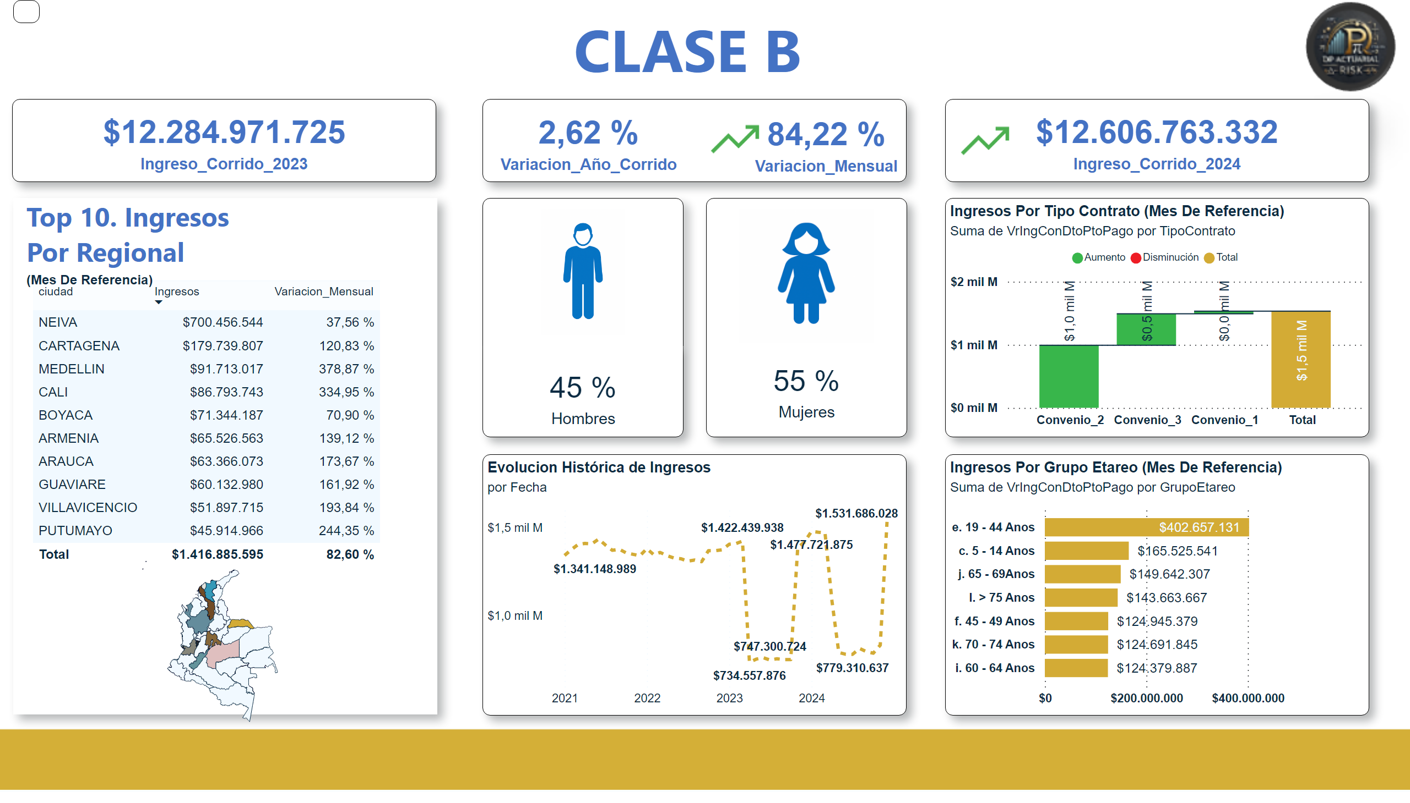
CLASE B
Notes:
CLASE B
No alt text provided
card
No alt text provided
card
No alt text provided
Top 10
No alt text provided
Ingresos Por Grupo Etareo (Mes De Referencia)
No alt text provided
lineChart
No alt text provided
Ingresos Por Tipo Contrato (Mes De Referencia)
No alt text provided
Ingresos Por Regional
No alt text provided
shape
No alt text provided
Top 10. Ingresos Por Regional
No alt text provided
card
No alt text provided
card
No alt text provided
card
No alt text provided
image
No alt text provided
card
No alt text provided
image
No alt text provided
shape
No alt text provided
shape
No alt text provided
shape
No alt text provided
image
No alt text provided
slicer
No alt text provided
slicer
No alt text provided
image
No alt text provided

Slide 11

CLASE G
Notes:
CLASE G
No alt text provided
card
No alt text provided
card
No alt text provided
Top 10
No alt text provided
Ingresos Por Grupo Etareo (Mes De Referencia)
No alt text provided
lineChart
No alt text provided
Ingresos Por Tipo Contrato (Mes De Referencia)
No alt text provided
Ingresos Por Regional
No alt text provided
shape
No alt text provided
Top 10. Ingresos Por Regional
No alt text provided
card
No alt text provided
card
No alt text provided
card
No alt text provided
image
No alt text provided
card
No alt text provided
image
No alt text provided
shape
No alt text provided
shape
No alt text provided
shape
No alt text provided
image
No alt text provided
image
No alt text provided
slicer
No alt text provided
slicer
No alt text provided

Slide 12
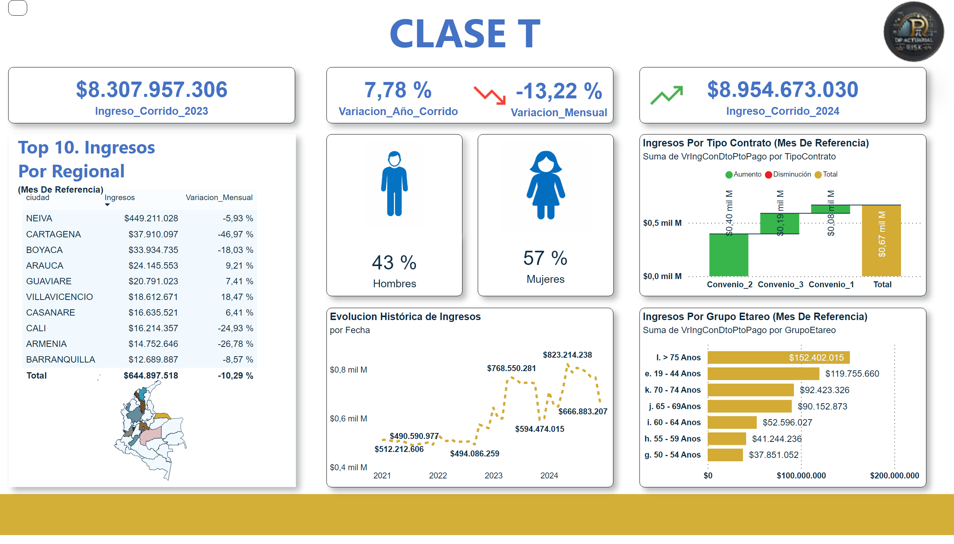
CLASE T
Notes:
CLASE T
No alt text provided
card
No alt text provided
card
No alt text provided
Top 10
No alt text provided
Ingresos Por Grupo Etareo (Mes De Referencia)
No alt text provided
lineChart
No alt text provided
Ingresos Por Tipo Contrato (Mes De Referencia)
No alt text provided
Ingresos Por Regional
No alt text provided
shape
No alt text provided
Top 10. Ingresos Por Regional
No alt text provided
card
No alt text provided
card
No alt text provided
card
No alt text provided
image
No alt text provided
card
No alt text provided
image
No alt text provided
shape
No alt text provided
shape
No alt text provided
shape
No alt text provided
image
No alt text provided
slicer
No alt text provided
slicer
No alt text provided
image
No alt text provided

Slide 13
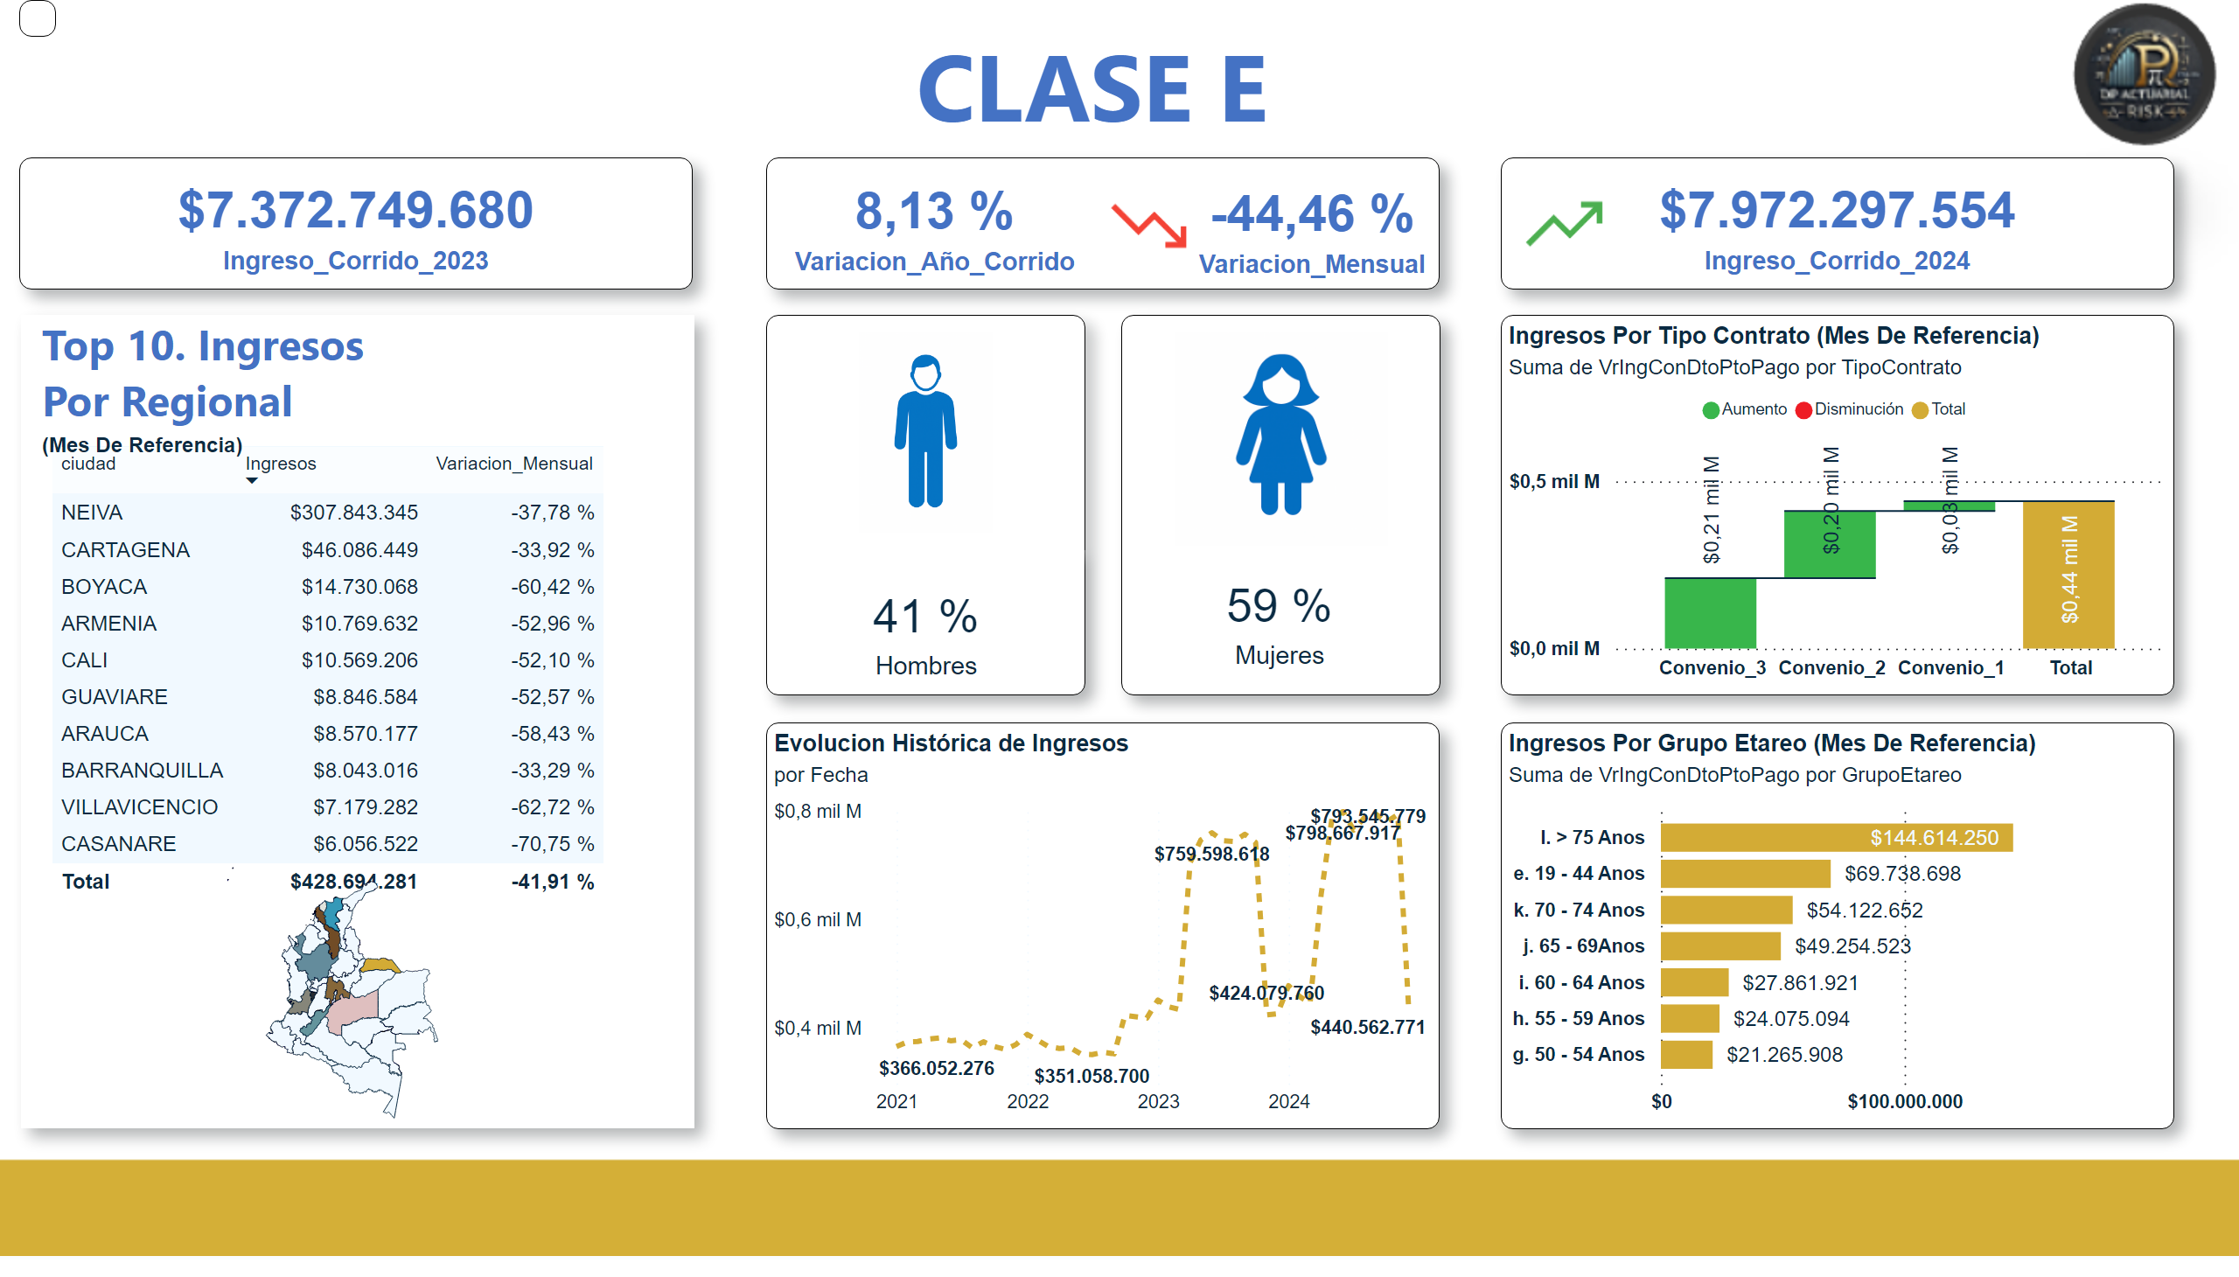
CLASE E
Notes:
CLASE E
No alt text provided
card
No alt text provided
card
No alt text provided
Top 10
No alt text provided
Ingresos Por Grupo Etareo (Mes De Referencia)
No alt text provided
lineChart
No alt text provided
Ingresos Por Tipo Contrato (Mes De Referencia)
No alt text provided
Ingresos Por Regional
No alt text provided
shape
No alt text provided
Top 10. Ingresos Por Regional
No alt text provided
card
No alt text provided
card
No alt text provided
card
No alt text provided
image
No alt text provided
card
No alt text provided
image
No alt text provided
shape
No alt text provided
shape
No alt text provided
shape
No alt text provided
image
No alt text provided
slicer
No alt text provided
slicer
No alt text provided
image
No alt text provided

Slide 14
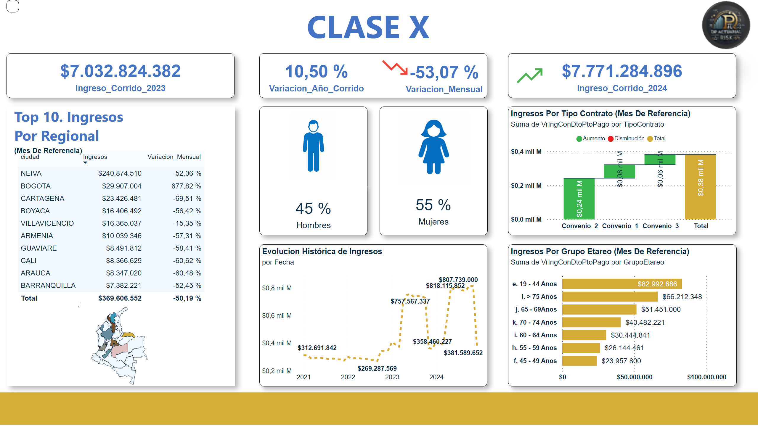
CLASE X
Notes:
CLASE X
No alt text provided
card
No alt text provided
card
No alt text provided
Top 10
No alt text provided
Ingresos Por Grupo Etareo (Mes De Referencia)
No alt text provided
lineChart
No alt text provided
Ingresos Por Tipo Contrato (Mes De Referencia)
No alt text provided
Ingresos Por Regional
No alt text provided
shape
No alt text provided
Top 10. Ingresos Por Regional
No alt text provided
card
No alt text provided
card
No alt text provided
card
No alt text provided
image
No alt text provided
card
No alt text provided
image
No alt text provided
shape
No alt text provided
shape
No alt text provided
shape
No alt text provided
image
No alt text provided
slicer
No alt text provided
slicer
No alt text provided
image
No alt text provided

Slide 15

CLASE L
Notes:
CLASE L
No alt text provided
card
No alt text provided
card
No alt text provided
Top 10
No alt text provided
Ingresos Por Grupo Etareo (Mes De Referencia)
No alt text provided
lineChart
No alt text provided
Ingresos Por Tipo Contrato (Mes De Referencia)
No alt text provided
Ingresos Por Regional
No alt text provided
shape
No alt text provided
Top 10. Ingresos Por Regional
No alt text provided
card
No alt text provided
card
No alt text provided
card
No alt text provided
image
No alt text provided
card
No alt text provided
image
No alt text provided
shape
No alt text provided
shape
No alt text provided
shape
No alt text provided
image
No alt text provided
slicer
No alt text provided
slicer
No alt text provided
image
No alt text provided

Slide 16

CLASE C
Notes:
CLASE C
No alt text provided
card
No alt text provided
card
No alt text provided
Top 10
No alt text provided
Ingresos Por Grupo Etareo (Mes De Referencia)
No alt text provided
lineChart
No alt text provided
Ingresos Por Tipo Contrato (Mes De Referencia)
No alt text provided
Ingresos Por Regional
No alt text provided
shape
No alt text provided
Top 10. Ingresos Por Regional
No alt text provided
card
No alt text provided
card
No alt text provided
card
No alt text provided
image
No alt text provided
card
No alt text provided
image
No alt text provided
shape
No alt text provided
shape
No alt text provided
shape
No alt text provided
image
No alt text provided
slicer
No alt text provided
slicer
No alt text provided
image
No alt text provided

Slide 17

CLASE V
Notes:
CLASE V
No alt text provided
card
No alt text provided
card
No alt text provided
Top 10
No alt text provided
Ingresos Por Grupo Etareo (Mes De Referencia)
No alt text provided
lineChart
No alt text provided
Ingresos Por Tipo Contrato (Mes De Referencia)
No alt text provided
Ingresos Por Regional
No alt text provided
shape
No alt text provided
Top 10. Ingresos Por Regional
No alt text provided
card
No alt text provided
card
No alt text provided
card
No alt text provided
image
No alt text provided
card
No alt text provided
image
No alt text provided
shape
No alt text provided
shape
No alt text provided
shape
No alt text provided
image
No alt text provided
slicer
No alt text provided
slicer
No alt text provided
image
No alt text provided

Slide 18

CLASE A
Notes:
CLASE A
No alt text provided
card
No alt text provided
card
No alt text provided
Top 10
No alt text provided
Ingresos Por Grupo Etareo (Mes De Referencia)
No alt text provided
lineChart
No alt text provided
Ingresos Por Tipo Contrato (Mes De Referencia)
No alt text provided
Ingresos Por Regional
No alt text provided
shape
No alt text provided
Top 10. Ingresos Por Regional
No alt text provided
card
No alt text provided
card
No alt text provided
card
No alt text provided
image
No alt text provided
card
No alt text provided
image
No alt text provided
shape
No alt text provided
shape
No alt text provided
shape
No alt text provided
image
No alt text provided
slicer
No alt text provided
slicer
No alt text provided
image
No alt text provided

